Slide 1
CEIS 150 Stock Menu Project
By: Zach Dugger

Slide 2
CEIS150 Module 2
Class Diagrams
Class Coding
Unit Testing

Slide 3
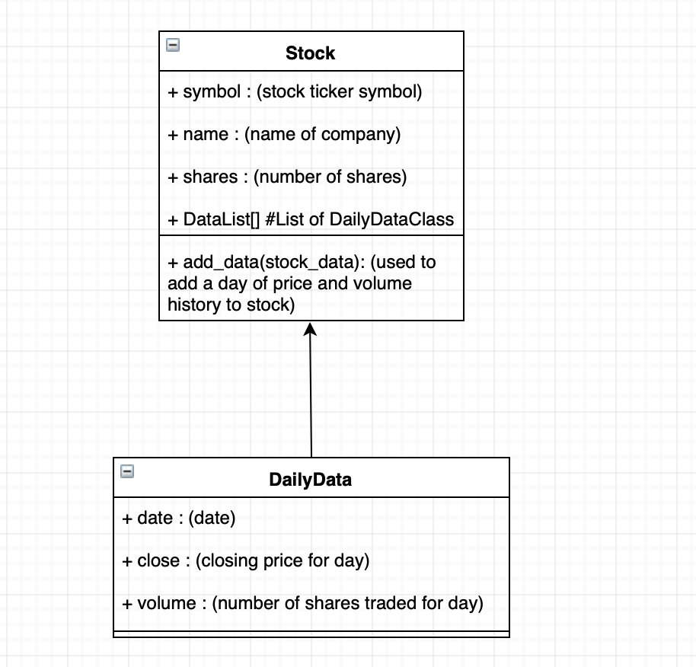
Class Diagram
Paste your Visio Class Diagram

Slide 4
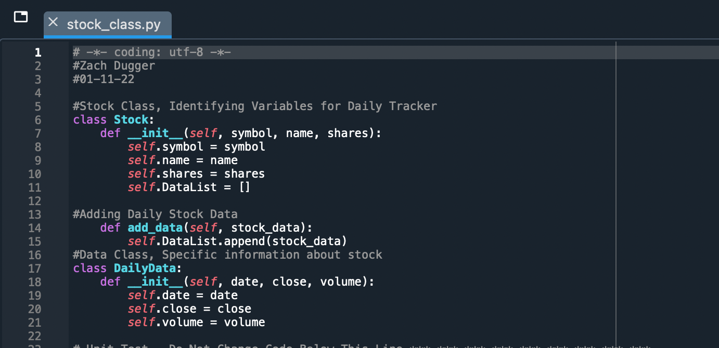
Class Code
Screen Shot of your stock_class.py file.

Slide 5
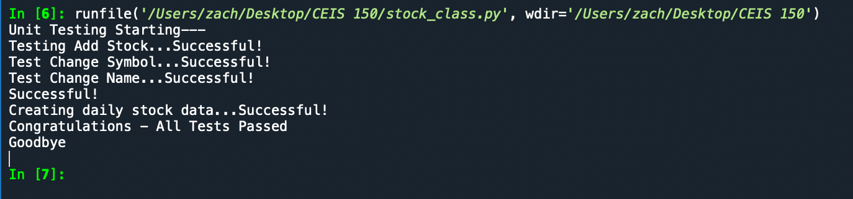
Unit Test
Screen Shot of your successful unit test.

Slide 6
Summary
In this module we learned the initializer function which was basically a staple for the rest of our projects.
Adding to that, this module also taught me basic methodology and order of processing when running programs through diagrams which are very helpful!

Slide 7
CEIS150 Module 3
Text-Based User Interface
Summary Report

Slide 8
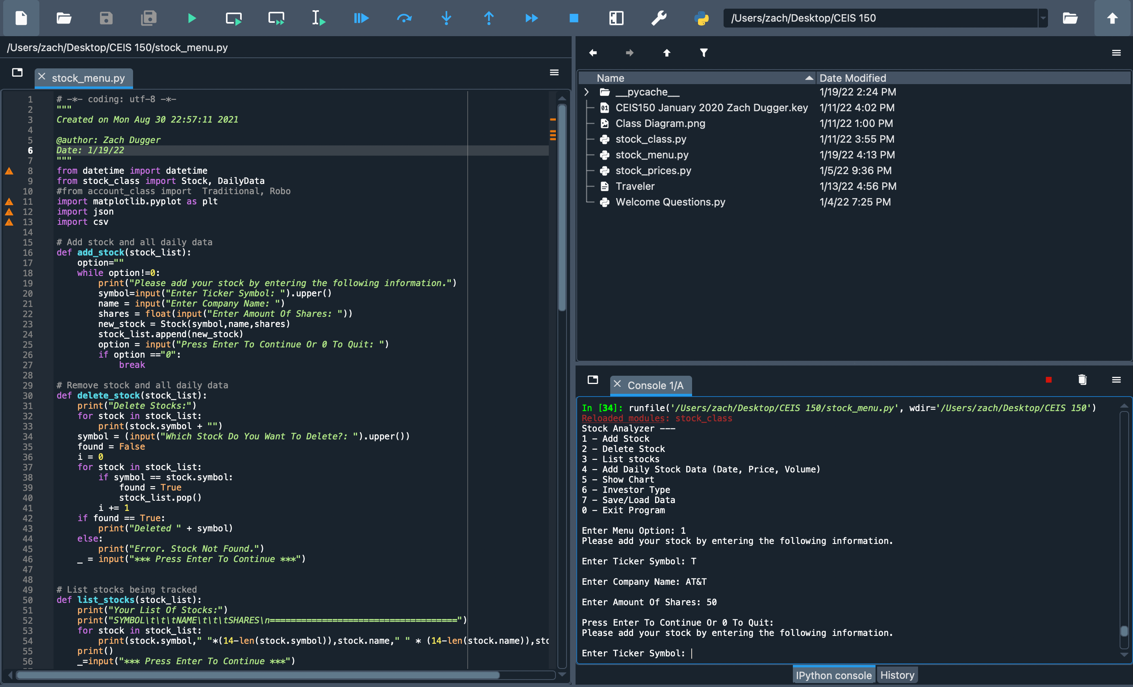
Adding a Stock

Slide 9
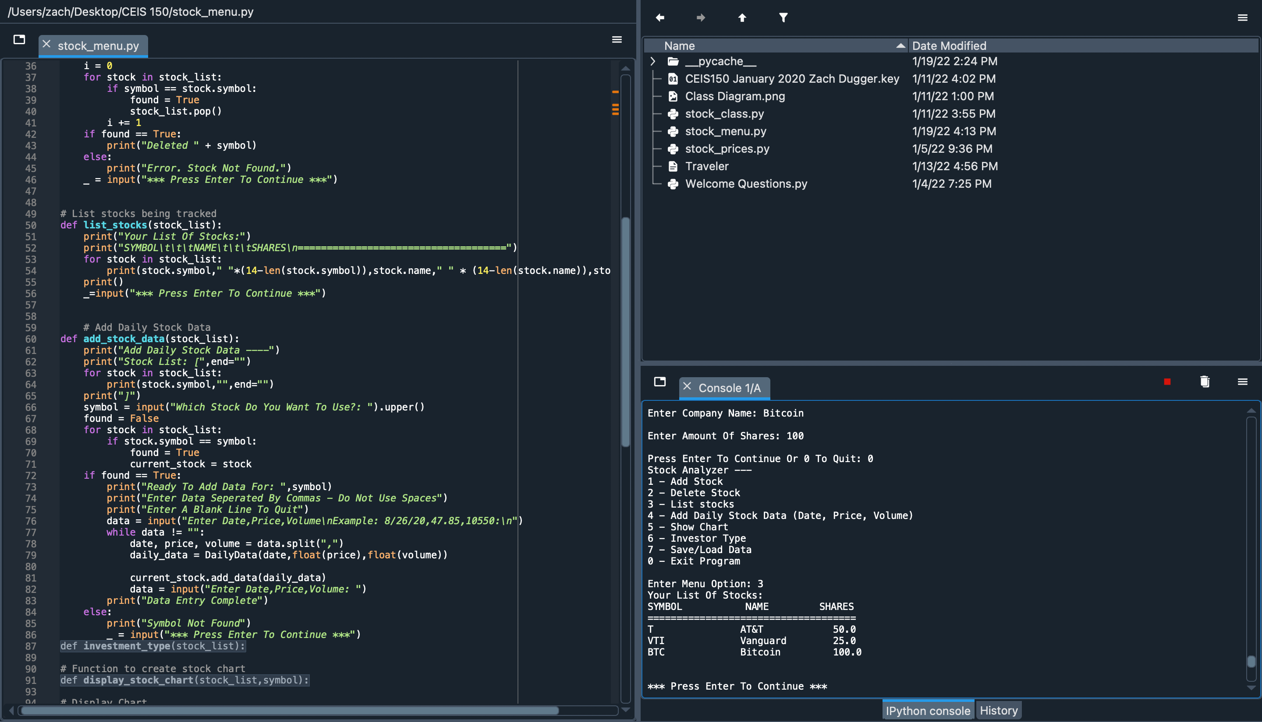
Listing 3 Stocks

Slide 10
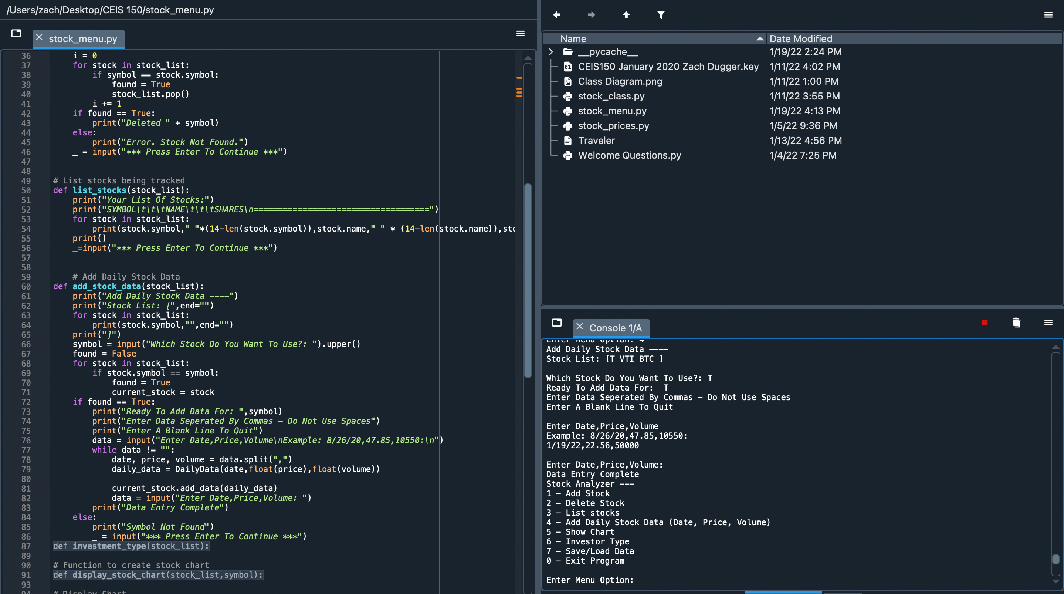
Daily Data

Slide 11
Summary:
This module was a lot of fun because it sparked my creativity. It taught me how user-interaction with a program would work in a real-life setting.

Slide 12
CEIS150 Module 4
Inheritance
Summary Report

Slide 13
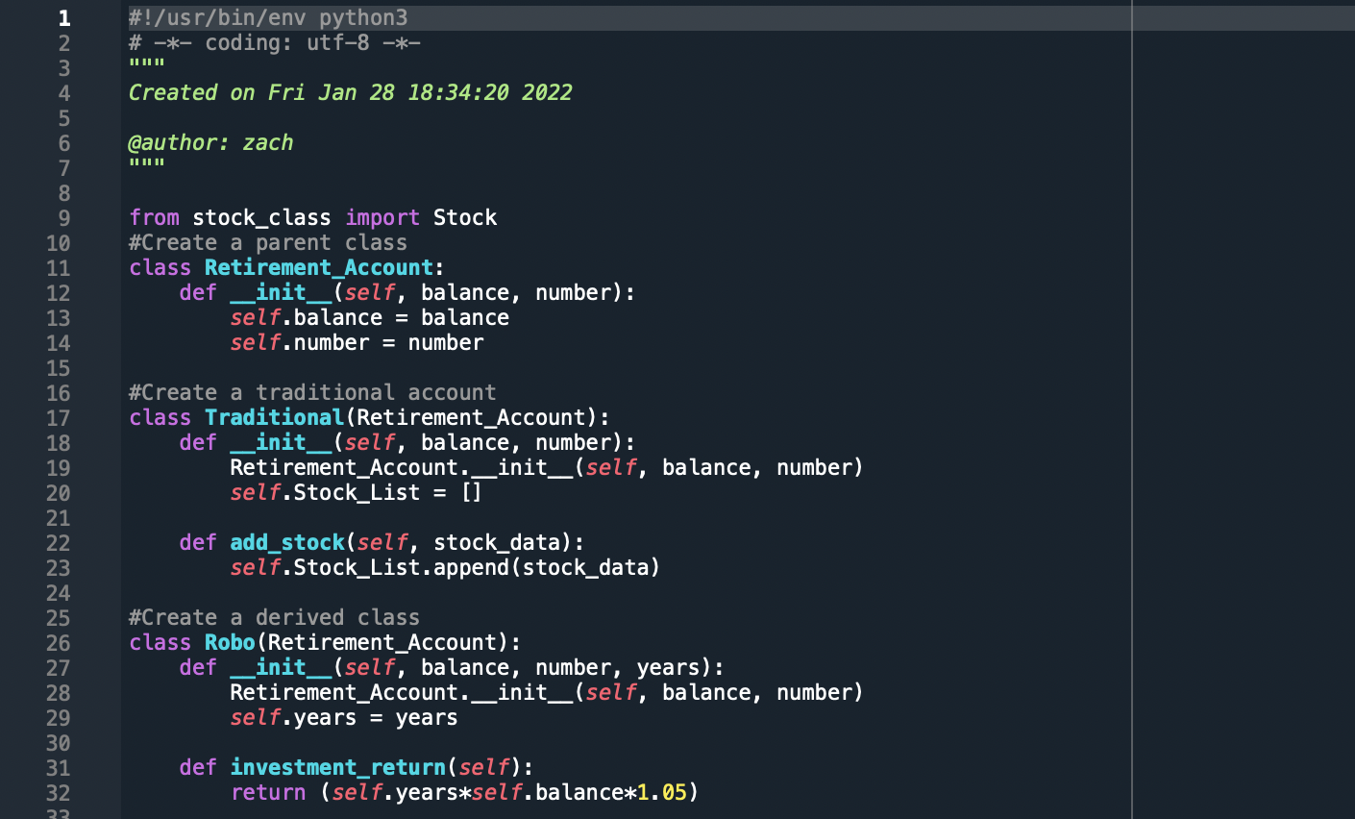
Inherited classes

Slide 14
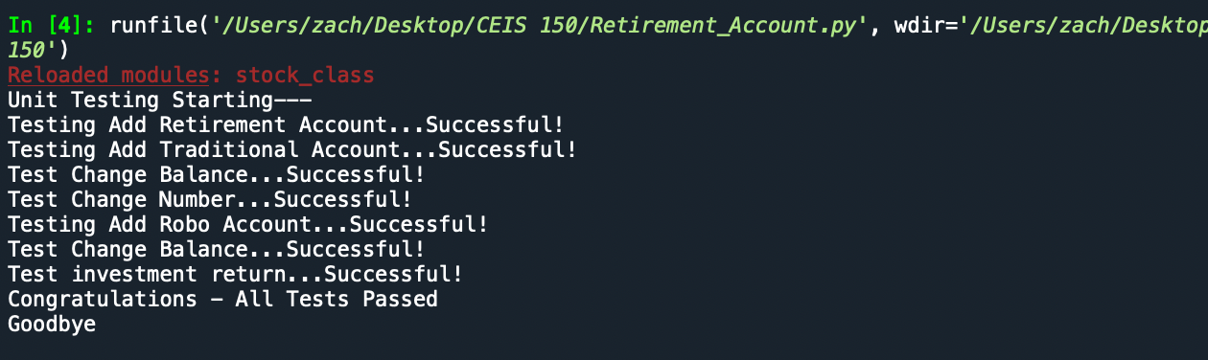
Unit Tests

Slide 15
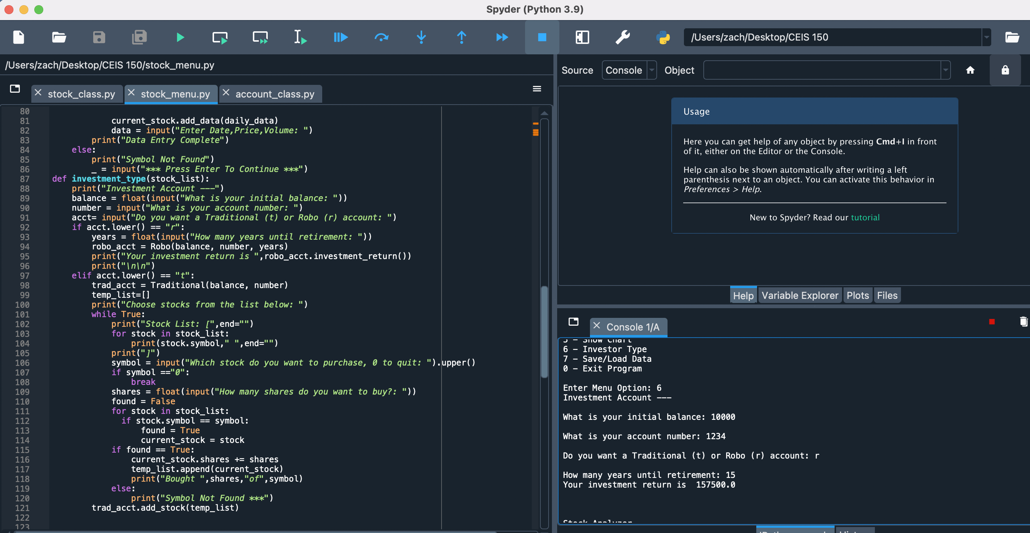
Stock menu program

Slide 16
Summary
Learning about inheritance was pretty challenging at first to understand. The concept is simple but putting it all together and making sure your code is perfect can be rough. The concept is amazing though and super time consuming.
Allowing a programmer to create sub-classes that inherit traits from a parents class to avoid having to retype similar lines of data.

Slide 17
CEIS150 Module 5
Creating a Chart

Slide 18
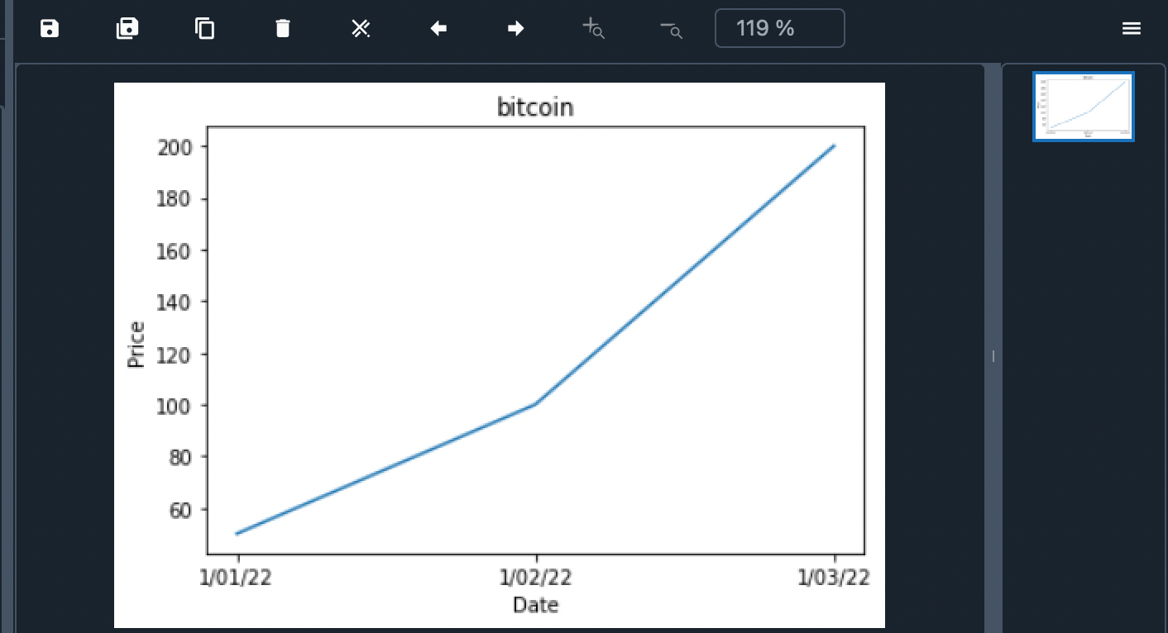
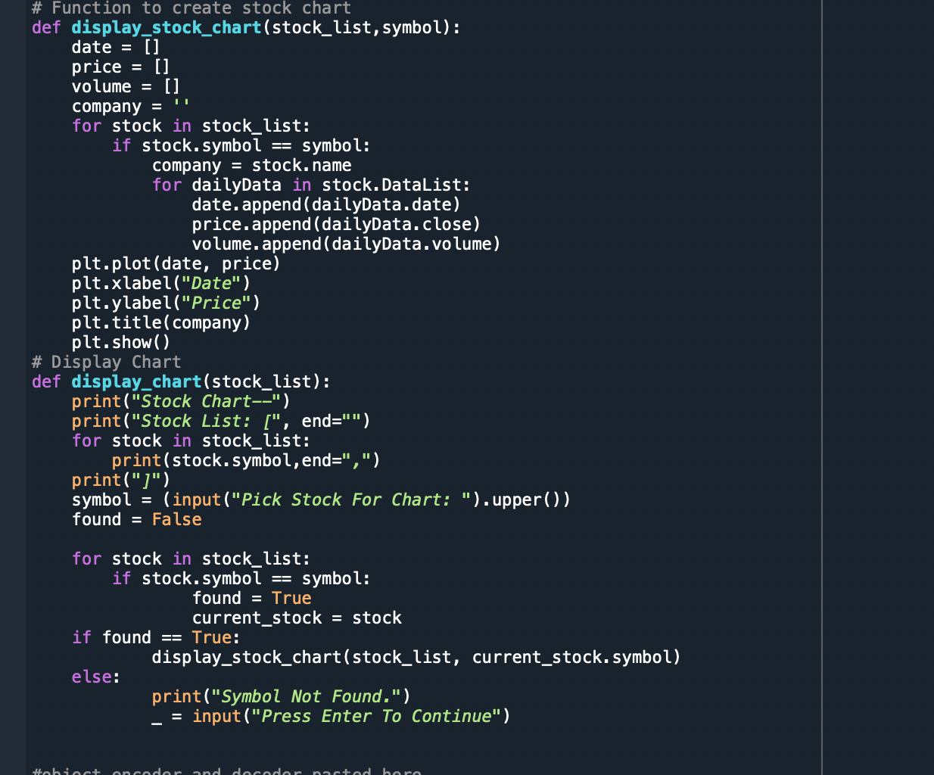
Chart
Paste a screen shot of your stock chart.

Slide 19
Summary:
This module really showed me how extensive the python library is and how useful the functions are within them. Allowing a programmer to automatically map charts from a csv file is really beneficial when comparing data to a team if it were in a real life setting.

Slide 20
CEIS150 Module 7
GUI

Slide 21
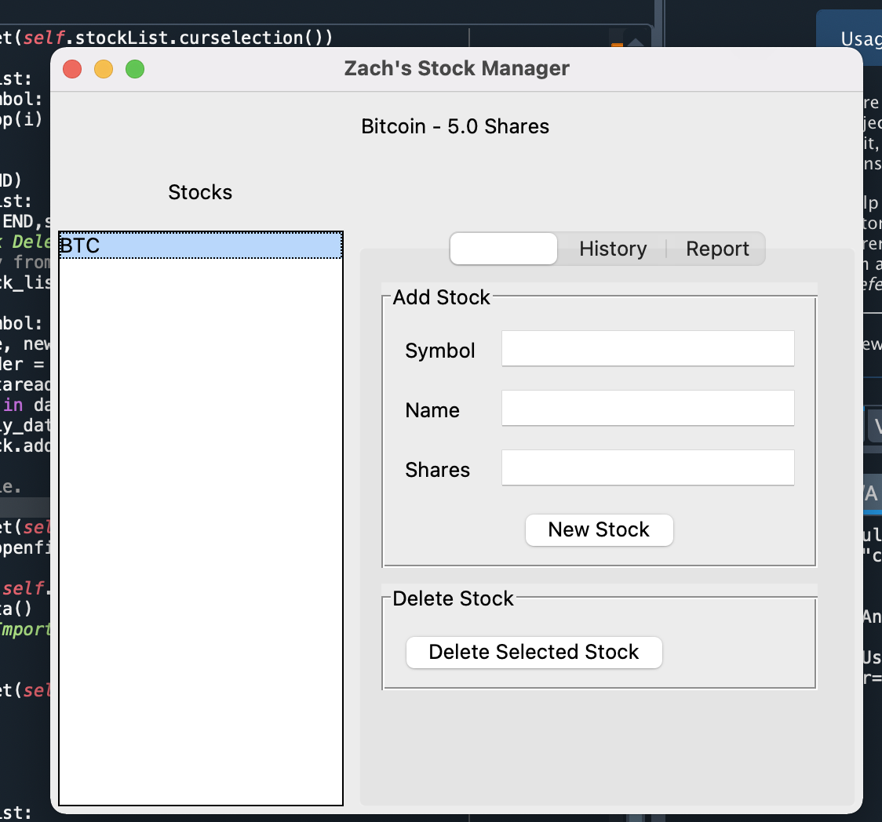
Stocks in GUI

Slide 22
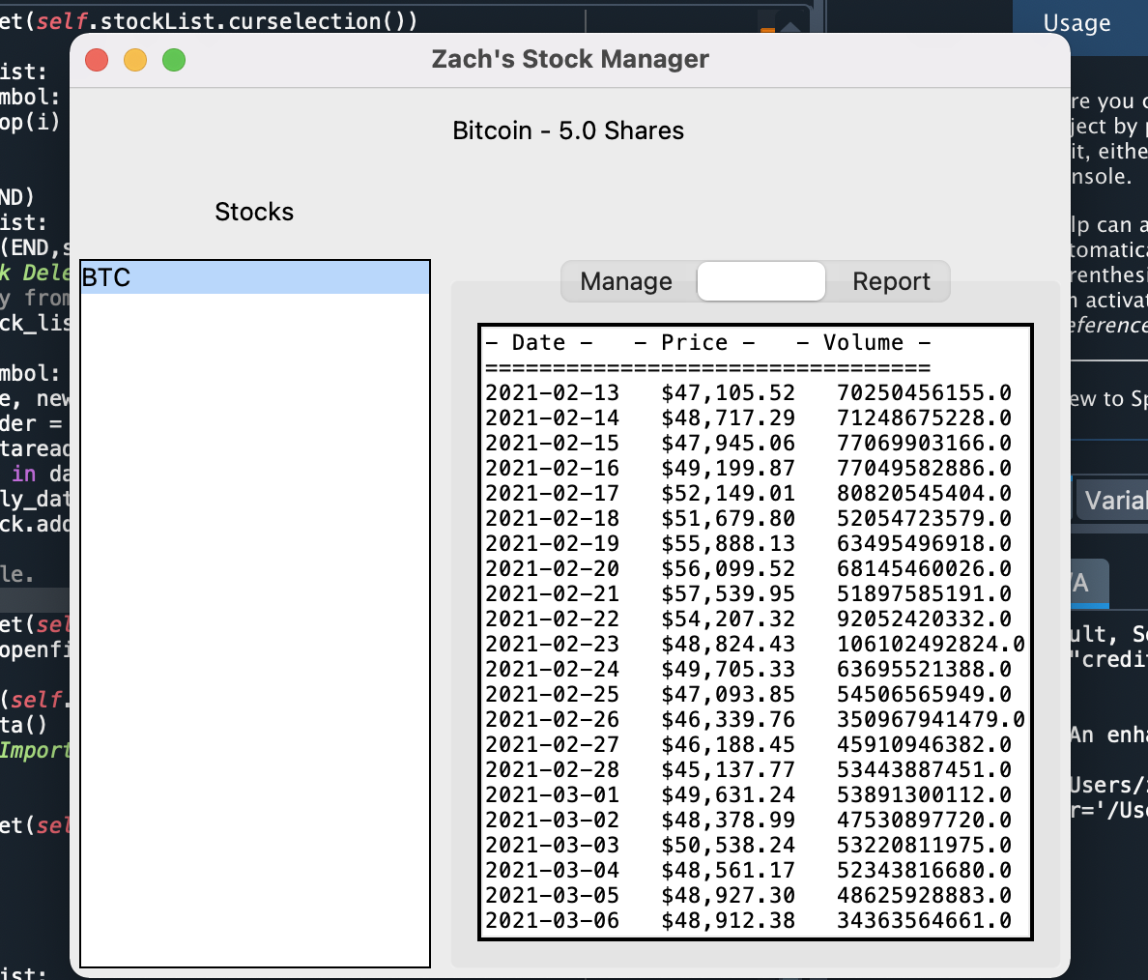
History Tab

Slide 23
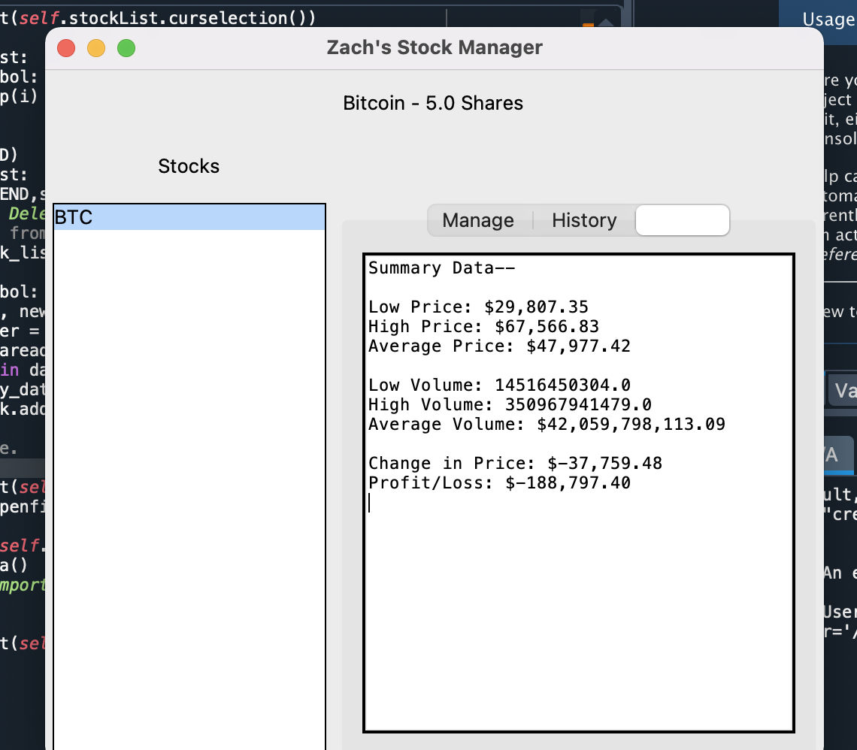
Report Complete

Slide 24
Summary:
This module was really interesting but also very confusing. I felt like learning the code for a GUI was like a whole new coding language but eventually I came to understand what the code is doing. All and all this style of code is probably what people see most often in Web and OS applications.

Slide 25
Challenges/Conclusion
I struggled a lot less with this class than my previous coding languages. I think this class is a really good opener for learning the process and functions of programming.
I did not struggle too much with anything in particular besides the GUI but if I did at all then the reference videos were super helpful to help me in the right direction to writing the code!

Slide 26
Career-Skills
Operating a system that uses Python or Python Libraries.
Creating a user-friendly program that is interactive.
Creating a program that will save/load/delete data.
Better understanding of how code makes its way through a development process.

